Slide 1


Big Data Platform Covid Tweet Analysis
Bhadri Vaidhyanathan

Slide 2




Summary
100Mil Tweets on Covid between Oct2021-Jan2022 reviewed and analyzed in the GCP using PySpark in JupyterLab
Tech Stack:
GCP
Apache Spark – PySpark
JupyterLab
Analysis themes:
Top Tweeters
Top Tweeter Personas
Location Analysis
Timeline Analysis
Parquet format selected for maximum efficiency in size and analysis process time

Slide 3
Data Profile
Size: 617.8 GB
Data dates: Oct 15,2021 to Jan 25,2022
Form: Tabular data with 100Mil rows or tweets and related meta data such as userid, timestamp, location and description.
Preprocessing:
Filtering
Tweet and Retweets with ‘covid’: 61Mil rows (60% of original)
50% of the extract are retweets (30Mil)
Data stored as parquet partitioned by year, month and date

Slide 4
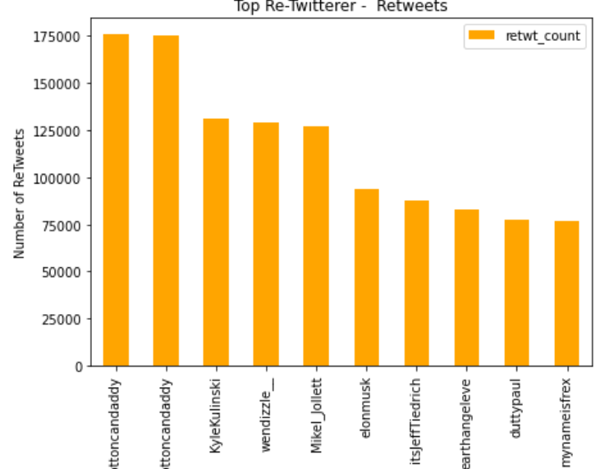
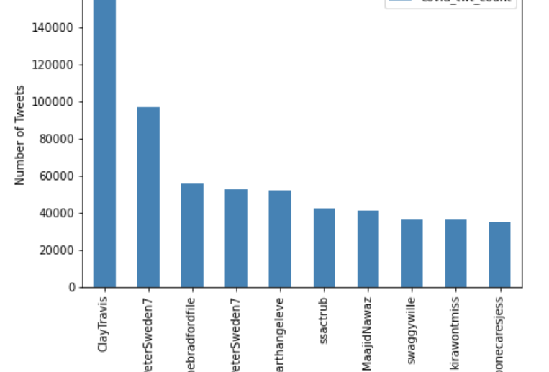
Top TwEEters
Total number of Unique Tweeters is 2Mil
The top tweeters and re-tweeters as shown below:

Slide 5

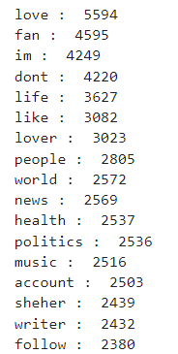
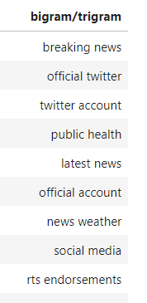
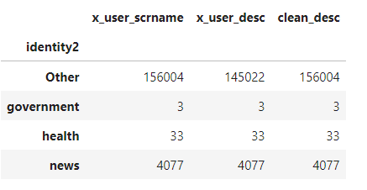
TwEEter PerSONAS
Methodology
2Mil users analysed
User description used to identify personas
Descriptions broken down and analyzed and 4 common themes identified based on frequency of key terms
NLP operations performed:
Description cleaned (stop words, punctuations etc) using Gensim
Word Count and Bi/Trigram analysis performed to and 4 groups, News, Government, health entity, Influencer and Others, created manually using the top terms.
Based on the number of words in the description from these lists, the entities were classified

Slide 6
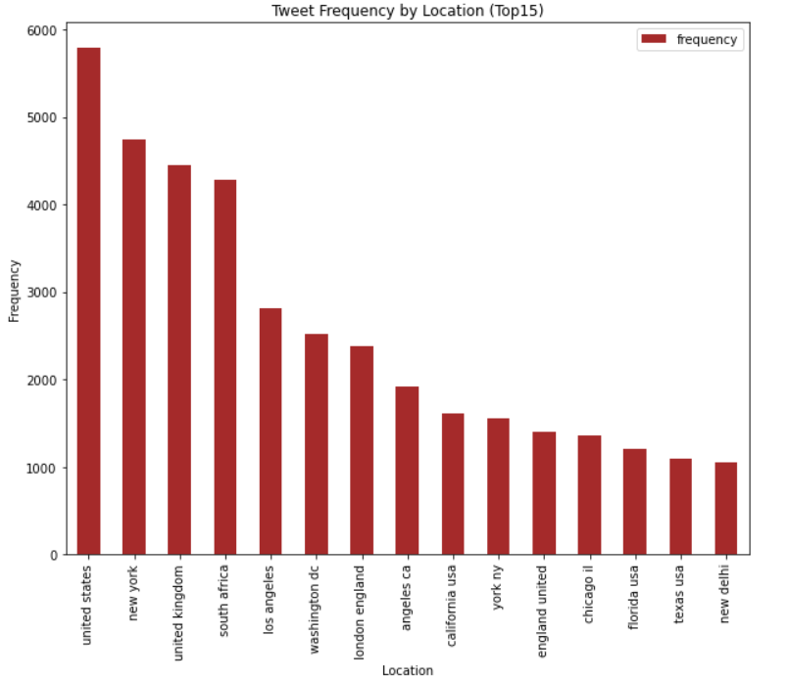
Location Analysis
United States and cities in US have the highest volume of tweet volume between Oct2021 - Jan 2022
United Kingdom and South Africa also feature in the top list during this period. The discovery of the highly contagious Omicron variant in South Africa and its spread in UK during this time period explains their presence.
https://www.cnn.com/2021/12/02/world/south-africa-omicron-origins-covid-cmd-intl/index.html https://www.who.int/news/item/26-11-2021-classification-of-omicron-(b.1.1.529)-sars-cov-2-variant-of-concern

Slide 7
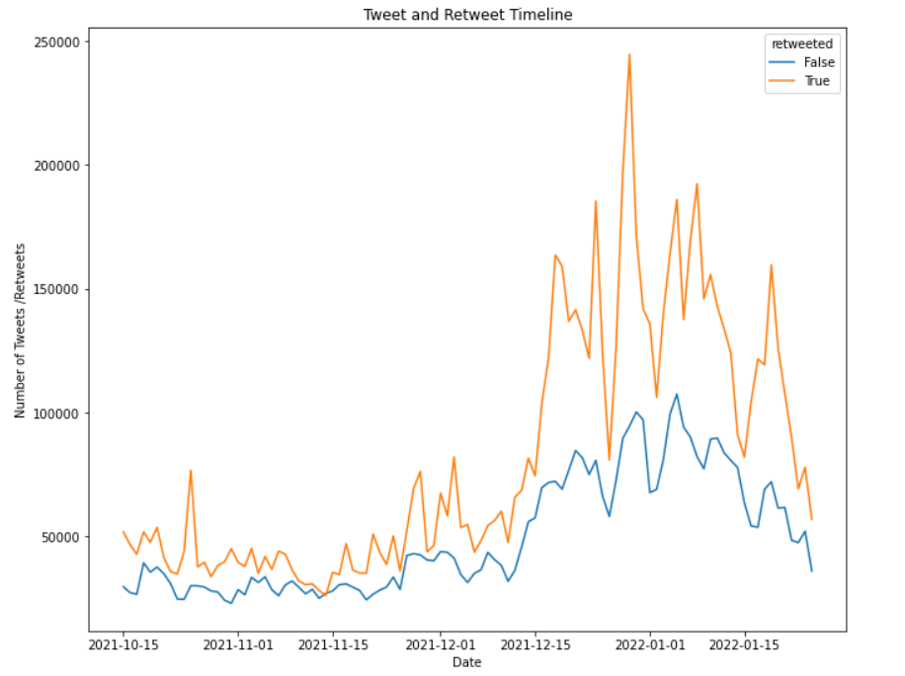
Time Analysis
Peak ReTweets in 29th Dec 2021
Valley on 26th Dec in ReTweets&Twewets due to Christmas and on 1st/2nd 2022 due to New Year’s holidays
Missing Data: The tweet and retweet ratio seem to be similar in the Oct/Nov 2021 but the differences peak in Dec2021 abd Jan 2022 indicating a possible gap in data collection

Slide 8
Conclusion
The peak in tweets does match correlate to the surge of the Omicron virus indicating the potential of using the Twitter platform as early warning for spread of contagious disease or occurrence of major disasters
Identifying Personas of the Users (Individual or Public Institution) enables analysis of identifying key influencers and mediums for passing communication
Considering the impact that Twitterer seem to have verification could provide the platform more credibiilty

